Slide 1
Introduction to Text Mining

Slide 2
Motivation for Text Mining
Approximately 90% of the world’s data is held in unstructured formats (source: Oracle Corporation)
Information intensive business processes demand that we transcend from simple document retrieval to “knowledge” discovery.
Structured Numerical or Coded
Information
10%
Unstructured or Semi-structured
Information
90%
Notes:
The justification for the interest in text mining is the same as for the interest in knowledge retrieval (search and categorization).
The shear amount of unstructured data (mostly textual) out there calls for more than just document retrieval. Tools and techniques exist to mine this data and realize value in the same way that data mining taps structured data for business intelligence and knowledge discovery.

Slide 3
Challenges of Text Mining
Very high number of possible “dimensions”
All possible word and phrase types in the language!!
Unlike data mining:
records (= docs) are not structurally identical
records are not statistically independent
Complex and subtle relationships between concepts in text
“AOL merges with Time-Warner”
“Time-Warner is bought by AOL”
Ambiguity and context sensitivity
automobile = car = vehicle = Toyota
Apple (the company) or apple (the fruit)
Notes:
Why aren’t there more products that do text mining?
Because it’s hard!!!
First, there are many possible dimensions of text. Consider just the classes of nouns that might be represented in a text collection. Then, add to that noun phrases (nouns plus adjectives or multi-word concepts).
Second, different documents can look quite different. Never mind issues like formatting differences.
Third, the relationships between words and concepts in text is subtle. Figuring out that a relationship exists is easy, providing the information about the nature of the relationship is tricky.
Finally, the same word can have many meanings (e.g. “interest”), or many words can have the same meaning.

Slide 4
The Emergence of Text Mining
Advances in text processing technology
Natural Language Processing (NLP)
Computational Linguistics
Cheap Hardware!
CPU
Disk
Network
Notes:
Why aren’t there more products that do text mining?
Because it’s hard!!!
First, there are many possible dimensions of text. Consider just the classes of nouns that might be represented in a text collection. Then, add to that noun phrases (nouns plus adjectives or multi-word concepts).
Second, different documents can look quite different. Never mind issues like formatting differences.
Third, the relationships between words and concepts in text is subtle. Figuring out that a relationship exists is easy, providing the information about the nature of the relationship is tricky.
Finally, the same word can have many meanings (e.g. “interest”), or many words can have the same meaning.

Slide 5
BOISE, Idaho (CNN) -- Cooler weather Monday in the U.S. Pacific Northwest may help more than 27,000 firefighters in their marathon battle against dozens of wildfires. Ten new large fires were reported overnight into Monday, bringing to 40 the number of large fires ablaze, said officials at the National Interagency Fire Center. They said between 300,000 and 400,000 acres are aflame. The good news is that five large fires were contained Sunday. So far, about 2.8 million acres of forest have burned this year, making 2001 an average year for fires. Center officials said 241 fires were reported Sunday into Monday but 96 percent were contained or extinguished in "initial attacks" by firefighters. A large fire is defined as a fire burning uncontained and extending over 100 acres or more.
Problem: Document Categorization
Politics
Economic
USA
World
xxxxxxx
xxx

Slide 6
Problem: Document Clustering
The long list of demands that President Bush laid out in a purposeful speech set a very tough standard for avoiding war.
Defiant in the face of criticism, Prime Minister Ariel Sharon today praised an attack that killed 13 Palestinians.
Signs emerged that the S.E.C. is deeply fractured over the search for candidates to fill the new board that will oversee the accounting profession.
Stocks rose this morning after a speech by President Bush helped rein in rampant war fears and lured skittish investors back into the market
Scrambling to save their proposed merger, EchoStar Communications and Hughes Electronics urged the F.C.C. to delay a decision on the $26 billion deal.

Slide 7
Problem: Document Clustering
The long list of demands that President Bush laid out in a purposeful speech set a very tough standard for avoiding war.
Scrambling to save their proposed merger, EchoStar Communications and Hughes Electronics urged the F.C.C. to delay a decision on the $26 billion deal.
Stocks rose this morning after a speech by President Bush helped rein in rampant war fears and lured skittish investors back into the market
Defiant in the face of criticism, Prime Minister Ariel Sharon today praised an attack that killed 13 Palestinians.
Signs emerged that the S.E.C. is deeply fractured over the search for candidates to fill the new board that will oversee the accounting profession.

Slide 8
Text Mining Definition
Many definitions in the literature
“The non trivial extraction of implicit, previously unknown, and potentially useful information from (large amount of) textual data”.
An exploration and analysis of textual (natural-language) data by automatic and semi automatic means to discover new knowledge.

Slide 9
Text Mining Definition
What is “previously unknown” information ?
Strict definition
Information that not even the writer knows.
e.g., Discovering a new method for a hair growth that is described as a side effect for a different procedure
Lenient definition
Rediscover the information that the author encoded in the text
e.g., Automatically extracting a product’s name from a web-page.

Slide 10
Outline
Text mining applications
Text characteristics
Text mining process
Learning methods

Slide 11
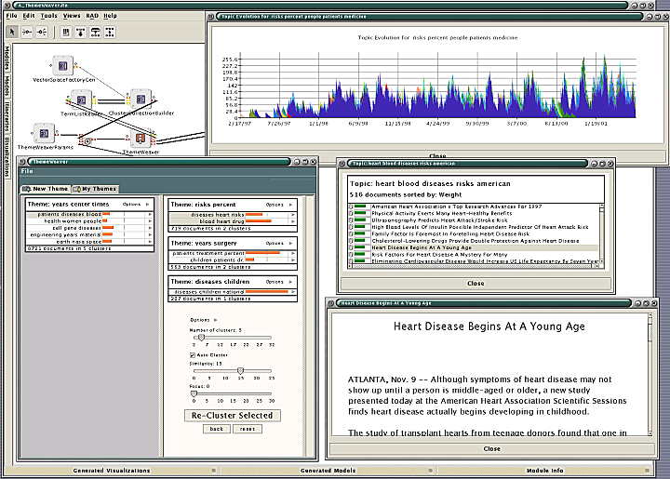
Text Mining Applications
Marketing: Discover distinct groups of potential buyers according to a user text based profile
e.g. amazon
Industry: Identifying groups of competitors web pages
e.g., competing products and their prices
Job seeking: Identify parameters in searching for jobs
e.g., www.flipdog.com

Slide 12
Text Mining Methods
Information Retrieval
Indexing and retrieval of textual documents
Information Extraction
Extraction of partial knowledge in the text
Web Mining
Indexing and retrieval of textual documents and extraction of partial knowledge using the web
Clustering
Generating collections of similar text documents

Slide 13
Information Retrieval
Documents
source
Given:
A source of textual documents
A user query (text based)
Query
E.g. Spam / Text
IR
System
Find:
A set (ranked) of documents that are relevant to the query
Document
Ranked
Documents
Document
Document

Slide 14
Intelligent Information Retrieval
meaning of words
Synonyms “buy” / “purchase”
Ambiguity “bat” (baseball vs. mammal)
order of words in the query
stand in the amusement park
amusement stand in the dog park
user dependency for the data
direct feedback
indirect feedback
authority of the source
IBM is more likely to be an authorized source then my second far cousin

Slide 15
What is Information Extraction?
Given:
A source of textual documents
A well defined limited query (text based)
Find:
Sentences with relevant information
Extract the relevant information and
ignore non-relevant information (important!)
Link related information and output in a predetermined format

Slide 16
Information Extraction: Example
Salvadoran President-elect Alfredo Cristiania condemned the terrorist killing of Attorney General Roberto Garcia Alvarado and accused the Farabundo Marti Natinal Liberation Front (FMLN) of the crime. … Garcia Alvarado, 56, was killed when a bomb placed by urban guerillas on his vehicle exploded as it came to a halt at an intersection in downtown San Salvador. … According to the police and Garcia Alvarado’s driver, who escaped unscathed, the attorney general was traveling with two bodyguards. One of them was injured.
Incident Date: 19 Apr 89
Incident Type: Bombing
Perpetrator Individual ID: “urban guerillas”
Human Target Name: “Roberto Garcia Alvarado”
...

Slide 17
What is Information Extraction?
Documents
source
Query 1
(E.g. job title)
Query 2
(E.g. salary)
Extraction
System
Combine
Query Results
Ranked
Documents
Relevant Info 1
Relevant Info 2
Relevant Info 3

Slide 18
Why Mine the Web?
Enormous wealth of textual information on the Web.
Book/CD/Video stores (e.g., Amazon)
Restaurant information (e.g., Zagats)
Car prices (e.g., Carpoint)
Lots of data on user access patterns
Web logs contain sequence of URLs accessed by users
Possible to retrieve “previously unknown” information
People who ski also frequently break their leg.
Restaurants that serve sea food in California are likely to be outside San-Francisco

Slide 19
Mining the Web
Web
Spider
Documents
source
Query
IR / IE
System
Ranked
Documents
1. Doc1
2. Doc2
3. Doc3
.
.

Slide 20
Unique Features of the Web
The Web is a huge collection of documents where many contain:
Hyper-link information
Access and usage information
The Web is very dynamic
Web pages are constantly being generated (removed)
Challenge: Develop new Web mining algorithms to . . .
Exploit hyper-links and access patterns.
Be adaptable to its documents source

Slide 21
Intelligent Web Search
Combine the intelligent IR tools
meaning of words
order of words in the query
user dependency for the data
authority of the source
With the unique web features
retrieve Hyper-link information
utilize Hyper-link as input

Slide 22
What is Clustering ?
Given:
A source of textual documents
Similarity measure
e.g., how many words are common in these documents
Documents
source
Similarity measure
Clustering
System
Find:
Several clusters of documents that are relevant to each other
Doc
Doc
Doc
Doc
Doc
Doc
Doc
Doc
Doc
Doc

Slide 23
Outline
Text mining applications
Text characteristics
Text mining process
Learning methods

Slide 24
Text characteristics: Outline
Large textual data base
High dimensionality
Several input modes
Dependency
Ambiguity
Noisy data
Not well structured text

Slide 25
Text characteristics
Large textual data base
Efficiency consideration
over 2,000,000,000 web pages
almost all publications are also in electronic form
High dimensionality (Sparse input)
Consider each word/phrase as a dimension
Several input modes
e.g., Web mining: information about user is generated by semantics, browse pattern and outside knowledgebase.

Slide 26
Text characteristics
Dependency
relevant information is a complex conjunction of words/phrases
e.g., Document categorization.
Pronoun disambiguation.
Ambiguity
Word ambiguity
Pronouns (he, she …)
“buy”, “purchase”
Semantic ambiguity
The king saw the rabbit with his glasses. (multiple meanings)

Slide 27
Text characteristics
Noisy data
Example: Spelling mistakes
Not well structured text
Chat rooms
“r u available ?”
“Hey whazzzzzz up”
Speech

Slide 28
Outline
Text mining applications
Text characteristics
Text mining process
Learning methods

Slide 29
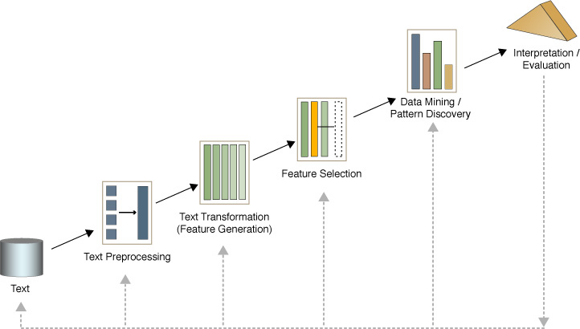
Text mining process

Slide 30
Text mining process
Text preprocessing
Syntactic/Semantic text analysis
Features Generation
Bag of words
Features Selection
Simple counting
Statistics
Text/Data Mining
Classification- Supervised learning
Clustering- Unsupervised learning
Analyzing results

Slide 31
Syntactic / Semantic text analysis
Part Of Speech (pos) tagging
Find the corresponding pos for each word
e.g., John (noun) gave (verb) the (det) ball (noun)
~98% accurate.
Word sense disambiguation
Context based or proximity based
Very accurate
Parsing
Generates a parse tree (graph) for each sentence
Each sentence is a stand alone graph

Slide 32
Feature Generation: Bag of words
Text document is represented by the words it contains (and their occurrences)
e.g., “Lord of the rings” → {“the”, “Lord”, “rings”, “of”}
Highly efficient
Makes learning far simpler and easier
Order of words is not that important for certain applications
Stemming: identifies a word by its root
e.g., flying, flew → fly
Reduce dimensionality
Stop words: The most common words are unlikely to help text mining
e.g., “the”, “a”, “an”, “you” …

Slide 33
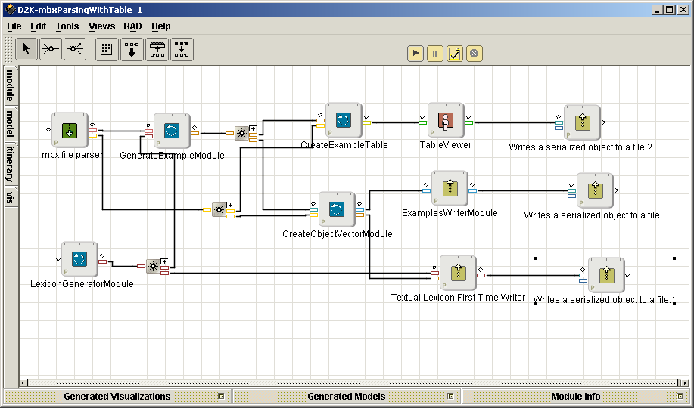
Feature Generation: D2K Example
Hi,
Here is your weekly update (that unfortunately hasn't gone out in about a month). Not much action here right now.
1) Due to the unwavering insistence of a member of the group, the ncsa.d2k.modules.core.datatype package is now completely independent of the d2k application.
2) Transformations are now handled differently in Tables. Previously, transformations were done using a TransformationModule. That module could then be added to a list that an ExampleTable kept. Now, there is an interface called Transformation and a sub-interface called ReversibleTransformation.
hi, weekly update (that unfortunately gone out month). much action here right now. 1) due unwavering insistence member group, ncsa.d2k.modules.core.datatype package now completely independent d2k application. 2) transformations now handled differently tables. previously, transformations done using transformationmodule. module added list exampletable kept. now, interface called transformation sub-interface called reversibletransformation.
hi week update unfortunate go out month much action here right now 1 due unwaver insistence member group ncsa d2k modules core datatype package now complete independence d2k application 2 transformation now handle different table previous transformation do use transformationmodule module add list exampletable keep now interface call transformation sub-interface call reversibletransformation

Slide 34
Feature Generation: XML
Current keyword-oriented search engines cannot handle rich queries like
Find all books authored by “Scooby-Doo”.
XML: Extensible Markup Language
XML documents have a nested structure in which each element is associated with a tag.
Tags describe the semantics of elements.
<book> <title> The making of a bad movie </title>
<author> <name> Scooby-Doo </name>
<affiliation> Cartoons </affiliation> </author>
</book>

Slide 35
Feature selection
Reduce dimensionality
Learners have difficulty addressing tasks with high dimensionality
Irrelevant features
Not all features help!
e.g., the existence of a noun in a news article is unlikely to help classify it as “politics” or “sport”

Slide 36
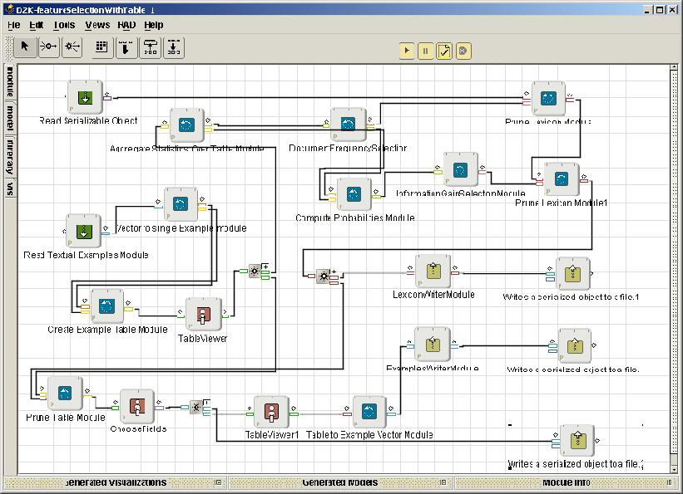
Feature selection: D2K Example I
hi
week
update
unfortunate
go
out
month
much
action
here
right
now
1
due
unwaver
insistence
member
group
ncsa
d2k
modules
do
core
datatype
package
complete
independence
application
2
transformation
handle
different
table
previous
use
transformationmodule
add
list
exampletable
keep
interface
call
sub-interface
reversibletransformation
hi
week
update
unfortunate
go
out
month
much
action
here
right
now
due
insistence
member
group
ncsa
d2k
modules
do
core
datatype
package
complete
independence
application
transformation
handle
different
table
previous
use
add
list
keep
interface
call
sub-interface

Slide 37
Feature selection: D2K Example II
hi
week
update
unfortunate
go
out
month
much
action
here
right
now
1
due
unwaver
insistence
member
group
ncsa
d2k
modules
do
core
datatype
package
complete
independence
application
2
transformation
handle
different
table
previous
use
transformationmodule
add
list
exampletable
keep
interface
call
sub-interface
reversibletransformation
hi
week
update
unfortunate
go
out
month
much
action
here
right
now
due
insistence
member
group
ncsa
d2k
modules
do
core
datatype
package
complete
independence
application
transformation
handle
different
table
previous
use
add
list
keep
interface
call
sub-interface
hi
week
update
unfortunate
month
action
right
due
insistence
member
group
ncsa
d2k
modules
core
datatype
package
complete
independence
application
transformation
handle
different
table
previous
add
list
interface
call
sub-interface

